Slide 1
Big Data Architecture and Governance
Individual Project |Tesla
Aaradhy Sharma

Slide 2
1. Selection Assignment

Slide 3
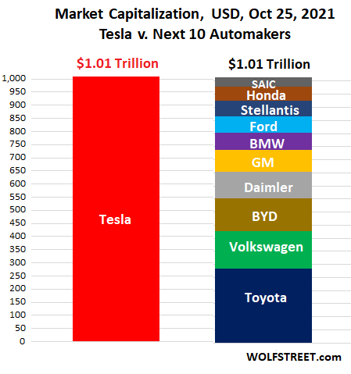
Tesla
Industry: Automotive, and energy generation and Storage
History/Background:
Tesla initially known as Tesla Motors was founded in 2003 by Martin Eberhard and Marc Trepanning in San Carlos.
The name tesla comes after a Genius Inventor Nikola Tesla who is known for his discoveries and invention in the field of electricity
Elon Musk join Tesla in 2004 and has become head of the chairman.
Tesla currently has the highest market cap of all car manufacturer

Slide 4
Issue Name: Supply Chain and Manufacturing
Tesla Currently facing supply chain issues with the production of its cars such as model 3, Model X, Model Y, and new Model S Plaid
With the Help of Big data several issues such as Sourcing, Production, and consumer feedback
For example, With the help of existing big data tesla can analyze that at which point it would be Beneficial to open a new plant in countries like India by understanding existing Indian car user behavior.

Slide 5
Impact Statement Guide
The purpose of this project is to improve Tesla Supply chain and help in keeping up with future demand

Slide 6
Issue Name: Battery Storage and Charging Issue
Along with Car manufacturing Tesla is also Dealing with Battery manufacturing and energy Storge as well Installing there Charging plant In the US, Eu, and China
Currently there is a big issue with battery storage and charging time and with increasing demand, this issue will grow even further
Using Big Data we can predict future power consumption at the grid and prepare accordingly such as having more storage and better allocation of existing resource
along with this using big data we can forecast user charging behavior so more plants can be installed effectively

Slide 7
Impact Statement Guide
The purpose of this project is to better allocate existing battery storage resources and install future projects accordingly to user demand to prevent outages and improve customer experience

